Slide 1
Integrating MMRd/MSI Testing for
Solid Tumors
دور تحليل MMRd /MSIفي الأورام الصلبة
د. موسى العلي
Mousa Alali, MD
Medical Oncologist

Slide 2
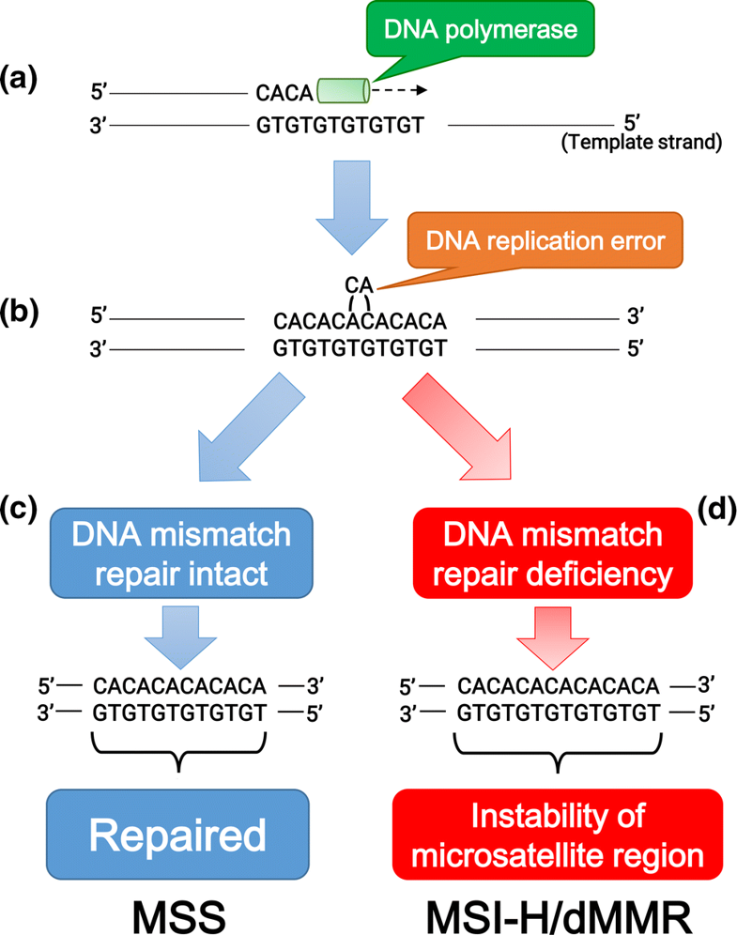
Microsatellite (MS) and mismatch repair (MMR):
Eso, Y. et al. J Gastroenterol (2019).
1/14

Slide 3
5-FU Can Harm Patients With MSI-H
Pooled data from randomized trials of 5-FU–based chemotherapy
in patients with stage II or stage III colon cancer
OS with microsatellite stability or low-frequency microsatellite instability
OS with high-frequency microsatellite instability
100
100
90
90
No adjuvant chemotherapy
Adjuvant chemotherapy
80
80
70
70
60
Adjuvant chemotherapy
60
OS (%)
OS (%)
50
50
No adjuvant chemotherapy
40
40
30
30
20
20
10
10
P = .02
P = .10
0
0
0
1
2
3
4
5
6
7
8
0
1
2
3
4
5
6
7
8
Yrs After Randomization
Yrs After Randomization
Patients at Risk, n
No adjuvant chemotherapy | 245 | 238 | 220 | 200 | 176 | 137 | 105 | 82 | 53
Adjuvant chemotherapy | 230 | 226 | 209 | 194 | 181 | 147 | 123 | 92 | 59
Patients at Risk, n
No adjuvant chemotherapy | 42 | 42 | 39 | 38 | 35 | 29 | 23 | 22 | 14
Adjuvant chemotherapy | 53 | 48 | 45 | 41 | 38 | 31 | 24 | 19 | 14
Ribic. NEJM. 2003;349:247.
2/14
Notes:
MSI-H, high microsatellite instability.

Slide 4
Relationship Between MSI and Tumor-Associated Inflammatory Response
Robust tumor-associated inflammatory response
Hypermutation
(10-100x increase in mutational load vs MMR-proficient tumors)
Many neoantigens expressed on tumor cells
MSI-H
High PD-1 and/or PD-L1 on tumor-infiltrating inflammatory cells
High PD-L1 on tumor cells
Le. NEJM. 2015;372:2509.
3/14
Notes:
MMR, mismatch repair; MSI, microsatellite instability; MSI-H, microsatellite instability–high.

Slide 5
Perspective
CRC stage ΙΙ & Ⅲ:
Oxaliplatin does not work in patients > 70 yrs of age
Adjuvant chemotherapy in MSI-H stage ΙΙ CRC: No benefit.
4/14
Notes:
MSI-H, high microsatellite instability.

Slide 6
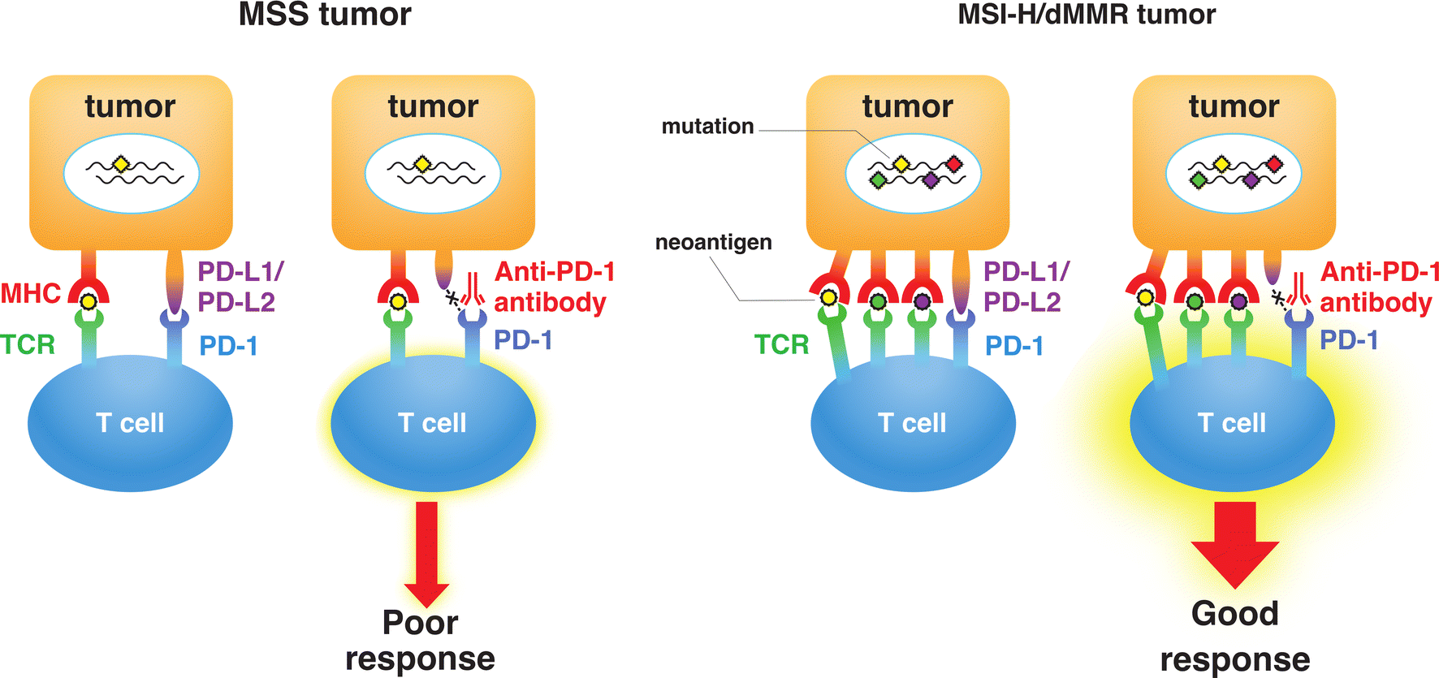
Eso, Y. et al. J Gastroenterol (2019).
5/14

Slide 7
MSI-H Frequency Among Different Types of Cancer
100
80
60
MSI-H Frequency (%)
40
20
0
Colon
Small Bowel
Endometrial
Gastric
Ovarian
Gallbladder
Prostate
Glioma
Breast
Lee. Oncologist. 2016;21:1200.
8/14
Notes:
MSI-H, high microsatellite instability.

Slide 8
Pembrolizumab: Non-CRC dMMR
Tumor Type^{[1]} | N | ORR, % (95% CI)
CRC | 90 | 36 (26-46)
Non-CRC | 59 | 46 (33-59)
Endometrial | 14 | 36 (13-65)
Biliary | 11 | 27 (6-61)
Gastric/GEJ | 9 | 56 (21-86)
Pancreatic | 6 | 83 (36-100)
Small Intestine | 8 | 38 (9-76)
Breast | 2 | PR, PR
Prostate | 2 | PR, SD
Bladder/esophageal | 1/1 | NE/PE
Sarcoma | 1 | PD
Thyroid | 1 | NE
Retroperitoneal adenocarcinoma | 1 | PR
SCLC | 1 | CR
Renal | 1 | PD
Tumor Type and Response^{[2]}
1. Pembrolizumab PI. 2. Le. Science. 2017;357:409.
9/14
Notes:
ORR, Objective Response Rate

Slide 9
Current Indications for Immune Checkpoint Inhibitors in MSI-H/dMMR Cancer
Pembrolizumab for MSI-high/MMRd unresectable or metastatic CRC with PD after a fluoropyrimidine, oxaliplatin or irinotecan
Pembrolizumab for MSI-high/MMRd unresectable or metastatic solid tumors with PD after prior treatment and no satisfactory alternative treatments
Nivolumab ± ipilimumab for MSI-high/MMRd metastatic CRC with PD after a fluoropyrimidine, oxaliplatin or irinotecan
10/14
Notes:
CPS, Combined Positive Score; GEJ, gastroesophageal junction

Slide 10
11/14

Slide 11
Case: Stage ΙΙ Colon Cancer
Patient Information
Specimen Information
Primary tumor: Ileocecal valve
Specimen site: Colon, NOS
74-yr-old woman with CAD is diagnosed with stage ΙΙ (T3N0) right colon cancer
IHC on biopsy: No MLH1/PMS2 = deficient MMR
Next-gen sequencing: MSI-H confirmed, TMB 25 mut/Mb
BRAF V600E positive
BRCA2 mutation positive
High Impact Results
Biomarker | Method | Result | Therapy Association |  | Biomarker Level
Mismatch repair status | IHC | Deficient | BENEFIT | Nivolumab, nivolumab/ipilimumab combination, pembrolizumab | Level 1
MSI | NGS | High | BENEFIT
BRAF | NGS | Mutated, Pathogenic Exon 15 | p.V600E | BENEFIT | Irinotecan + [cetuximab or panitumumab] + vemurafenib | Level 2
 |  |  | LACK OF BENEFIT | Vemurafenib/dabrafenib monotherapy | Level 3A
BRCA2 | NGS | Mutated, Pathogenic Exon 11 | p.N1784fs | BENEFIT | Olaparib | Level 3B
 |  |  | BENEFIT | oxaliplatin
13/14
Notes:
CAD, coronary artery disease; IHC, immunohistochemistry; MMR, mismatch repair; MSI-H, high microsatellite instability; TMB, tumor mutational burden.

Slide 12
شكراً لإصغائكم
شكراً لإصغائكم

